Slide 1

TEAM SWIFT
Lucas Monaco, Diya Patel, Janki Patel, Mark Habeb

Slide 2

Data Explanation
Name - the name of the song
Album - the name of the album
Release_date - the day month and year the album was released
Track number - the order the song appears on the album
Id - the Spotify id for the song
Url - the Spotify Url for the song.
Energy - Energy is a measure from 0.0 to 1.0 and represents a perceptual measure of intensity and activity. Typically, energetic tracks feel fast, loud, and noisy. For example, death metal has high energy, while a Bach prelude scores low on the scale. Perceptual features contributing to this attribute include dynamic range, perceived loudness, timbre, onset rate, and general entropy.

Slide 3

Data Explanation
liveness - Detects the presence of an audience in the recording. Higher liveness values represent an increased probability that the track was performed live. A value above 0.8 provides strong likelihood that the track is live.
loudness - The overall loudness of a track in decibels (dB). Loudness values are averaged across the entire track and are useful for comparing relative loudness of tracks. Loudness is the quality of a sound that is the primary psychological correlate of physical strength (amplitude). Values typically range between -60 and 0 db
Tempo - The overall estimated tempo of a track in beats per minute (BPM). In musical terminology, tempo is the speed or pace of a given piece and derives directly from the average beat duration.

Slide 4
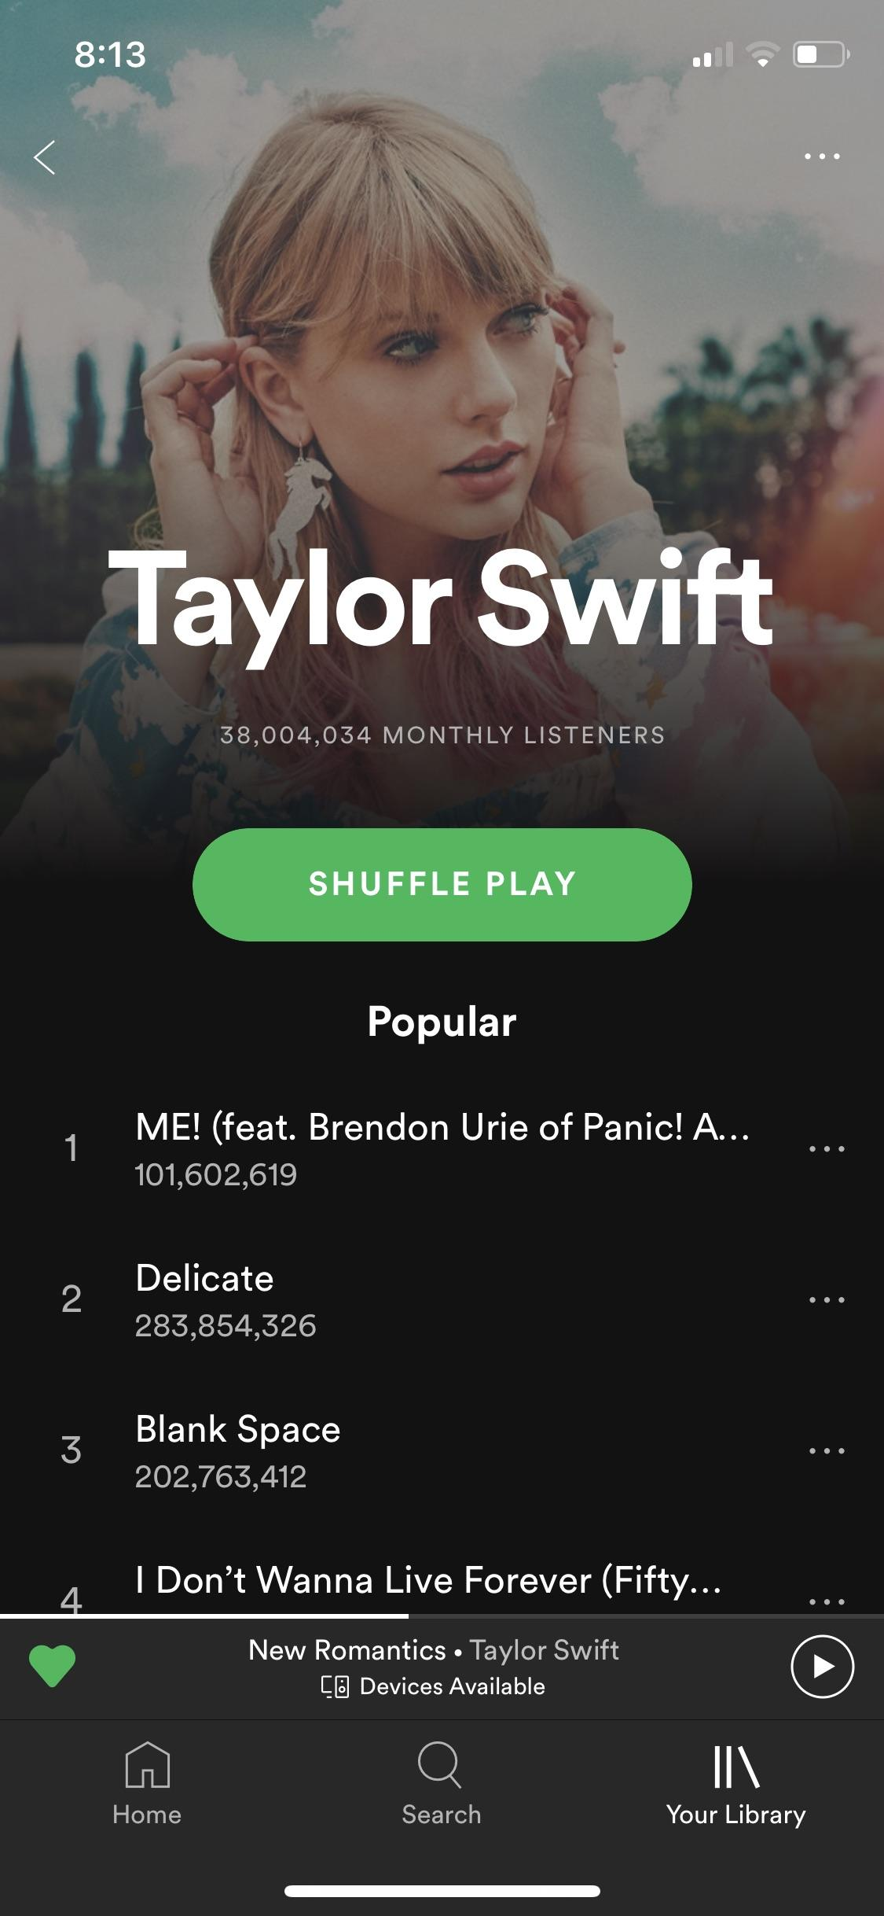
Data Explanation
Popularity - the popularity of the song from 0 to 100.
Duration_ms - The duration of the track in milliseconds.
Valence - A measure from 0.0 to 1.0 describing the musical positiveness conveyed by a track. Tracks with high valence sound more positive (e.g. happy, cheerful, euphoric), while tracks with low valence sound more negative (e.g. sad, depressed, angry).
Speechiness - detects the presence of spoken words in a track. The more exclusively speech-like the recording (e.g. talk show, audio book, poetry), the closer to 1.0 the attribute value. Values above 0.66 describe tracks that are probably made entirely of spoken words. Values between 0.33 and 0.66 describe tracks that may contain both music and speech, either in sections or layered, including such cases as rap music. Values below 0.33 most likely represent music and other non-speech-like tracks.

Slide 5

#1 Research Question
Is there any relationship/correlation between tempo and valence (musical positiveness)?

Slide 6
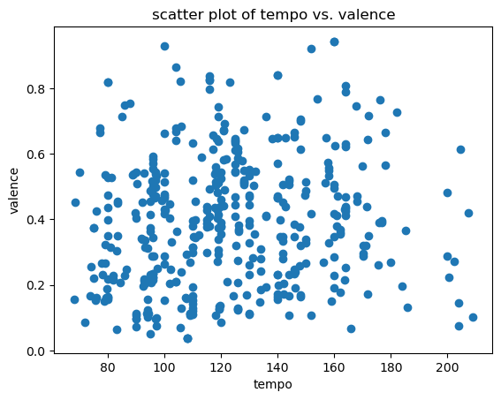
Tempo vs. Valence
There is very little correlation between tempo and valence. The r value is 0.12, which means very weak positive correlation. The scatterplot shows no shape that would indicate correlation either.

Slide 7
#2 Research Question
Is there any relationship/correlation between energy and danceability?

Slide 8
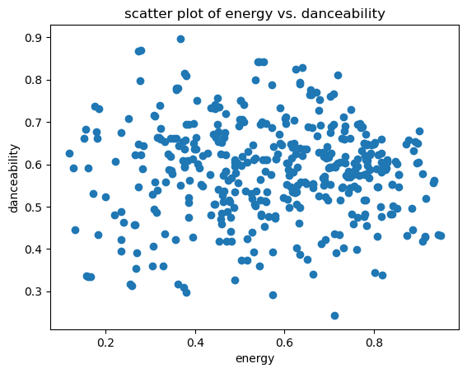
Energy vs. Danceability
There is almost no correlation between energy and danceability, with an r value of just -0.016. The negative value is interesting, but a number so close to zero means that there is basically no correlation to speak of. The scatterplot also shows very little shape or trend that might indicate a relationship.

Slide 9
#3 Research Question
what is the difference in popularity between albums re-released as "Taylor's Version" and the originals?

Slide 10
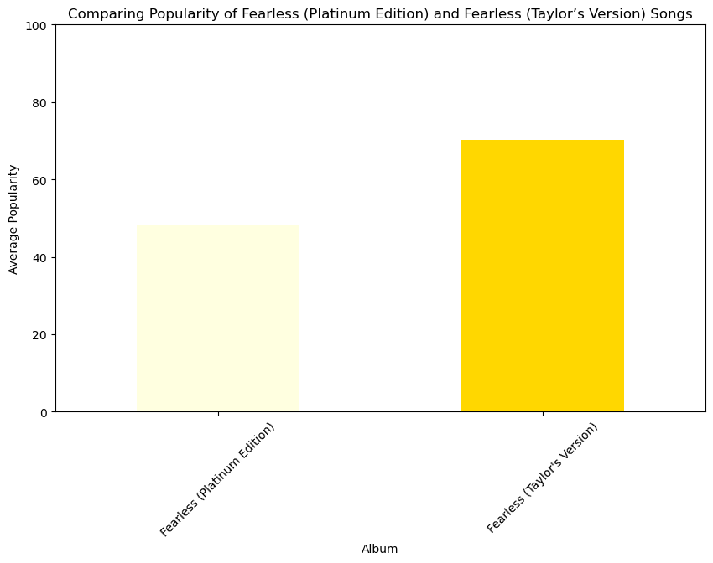
Popularity
Album
Fearless (Platinum Edition) …. 48.157895 Fearless (Taylor's Version) …. 70.307692

Slide 11
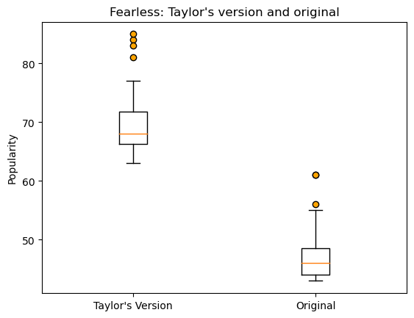
Taylor’s version vs. Original
There is a large difference in popularity between the original and Taylor's Version of the Fearless album.

Slide 12
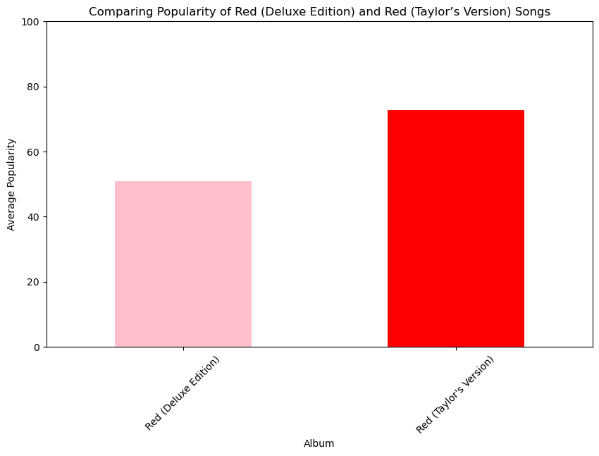
Popularity
Album
Red (Deluxe Edition) … 50.944444
Red (Taylor's Version) … 72.766667

Slide 13
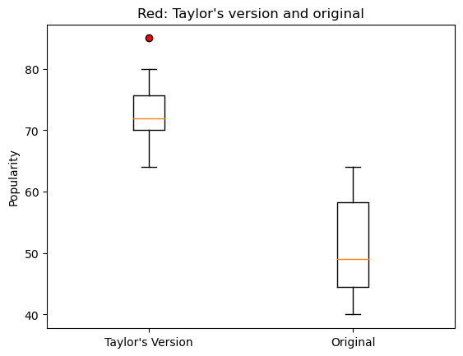
Taylor’s version vs. Original
All boxplots show the Taylor's Version of the albums having much higher popularity than the Original Version.

Slide 14
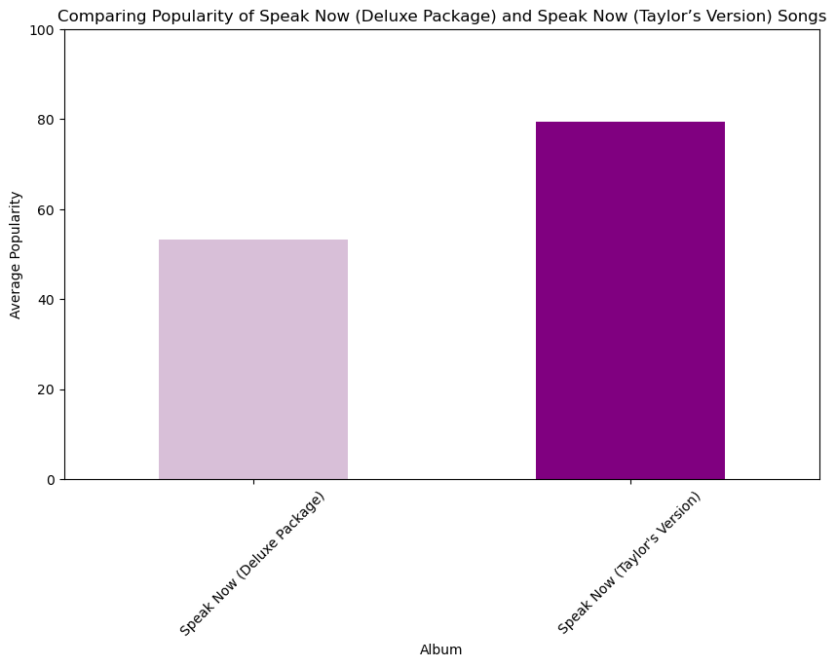
Popularity
Album
Speak Now (Deluxe Package) … 53.200000 Speak Now (Taylor's Version) … 79.363636

Slide 15
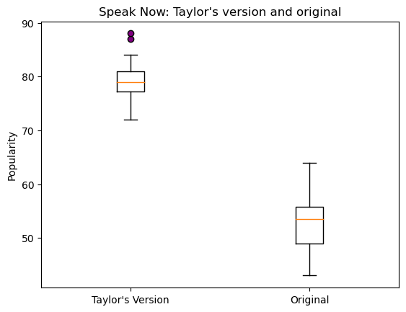
Taylor’s version vs. Original
All boxplots show the Taylor's Version of the albums having much higher popularity more than the Original Version

Slide 16
#4 Research Question
which, if any, numerical metrics that Spotify tracks are good predictors for popularity?

Slide 17
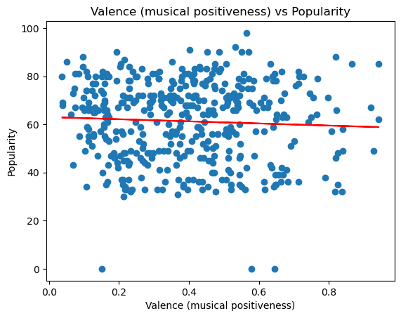
Valence vs Popularity
The r-value is -0.052 The regression line equation is: y = -4.39x + 63.03

Slide 18
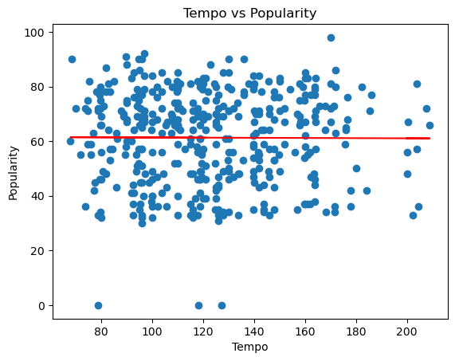
Tempo vs. Popularity
The r-value is -0.006 The regression line equation is: y = -0.00x + 61.68

Slide 19
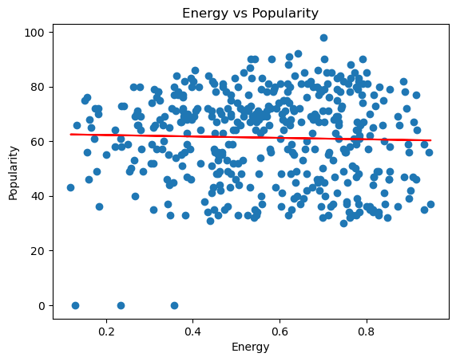
Energy vs. Popularity
The R-value is -0.031 The regression line equation is: y = -2.61x + 62.79

Slide 20
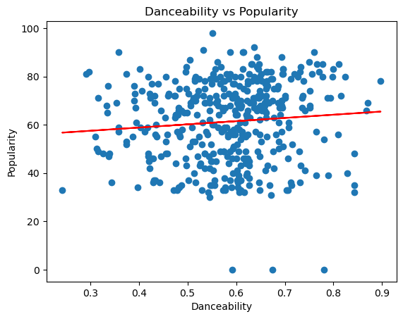
Danceability vs. Popularity
The r-value is 0.090 The regression line equation is: y = 13.31x + 53.53

Slide 21

References
https://www.kaggle.com/datasets/jarredpriester/taylor-swift-spotify-dataset?select=taylor_swift_spotify.csv

